Slide 1






MobileNet-based deep learning classifier for X-ray image diagnosis
Spatial Sciences Institute
Yifan Yang

Slide 2
Dataset and Deep learning classifier Goals:
Dataset Overview:
Source: COVID-19 Radiography Database
Content: Chest X-ray images with corresponding lung masks
Classes:
COVID-19 Positive: 3,616 cases
Normal: 10,192 cases
Lung Opacity (Non-COVID lung infection): 6,012 cases
Viral Pneumonia: 1,345 cases
Total Cases: 21,165
Deep Learning Classifier Goals:
Objective: Develop a deep learning model to classify X-ray images into four categories.
Classes: COVID-19 Positive, Normal, Lung Opacity, Viral Pneumonia.
Approach: Utilize MobileNet architecture for model development.
Task: The classifier should accurately assign each X-ray image to one of the aforementioned classes.

Slide 3
Methodology
Platform: Google Colab
1. Download data
Download the data and import the system library, data processing tools, and deep learning library, define the data path, and divide the data set into a training set, a verification set, and a test set.
2. Data preprocessing
Define a function that accepts a DataFrame of training, validation, and test sets and adapts them to the image data generator, since the model needs to get data from the image data generator. Image data generator converts images into tensors.
3. Create a pretrained model
Created a MobileNet-based deep learning model for classifying X-ray images.
4. Model evaluation
The respective losses and accuracy were calculated. The model was used to predict the test set and the confusion matrix was calculated. Calculate the precision, recall, and F1 score of the model on each category.

Slide 4
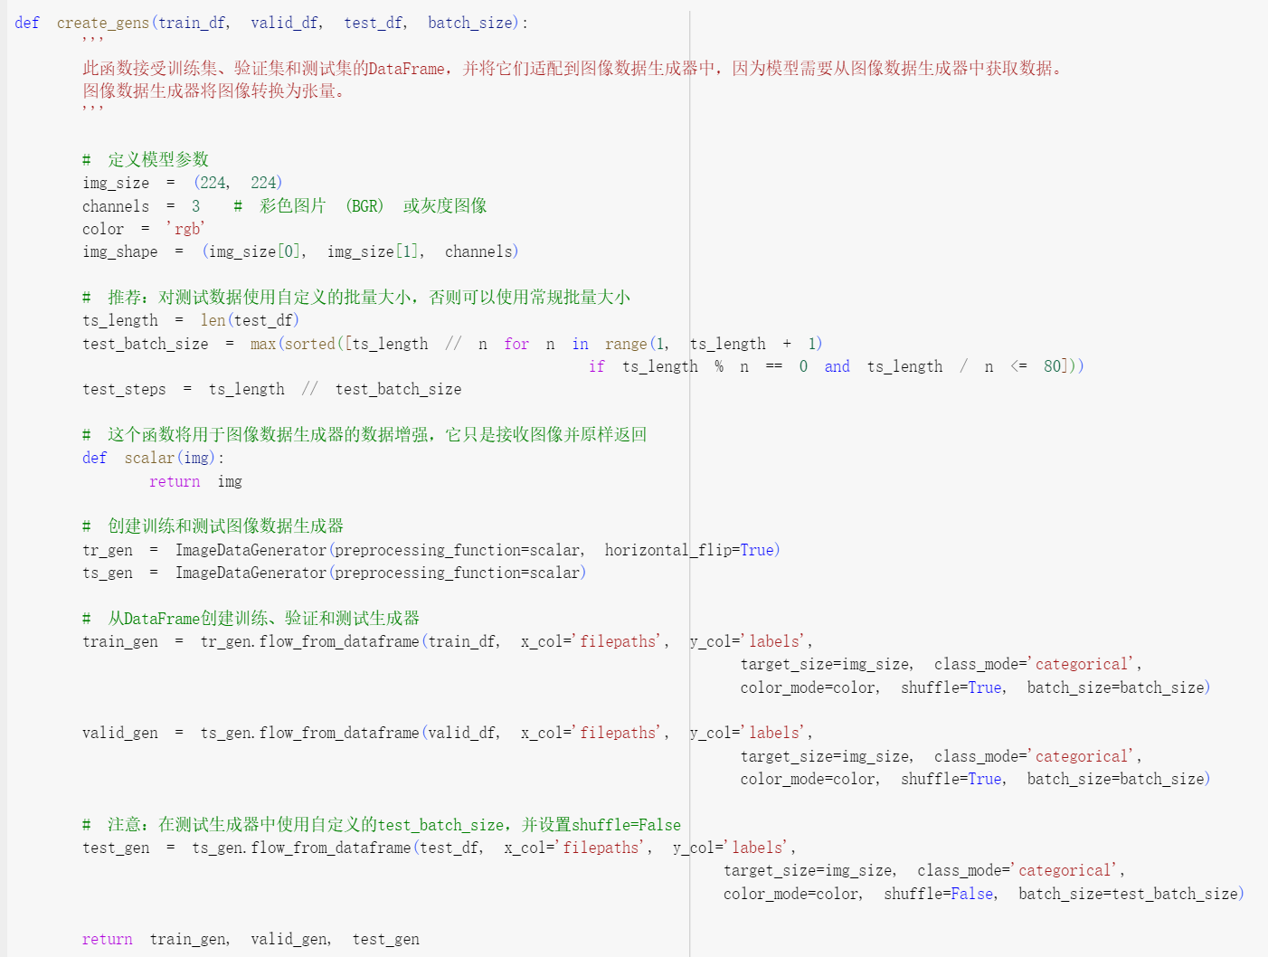
Data preprocessing

Slide 5
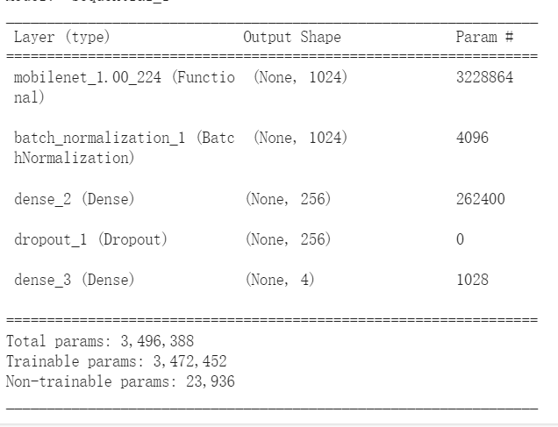
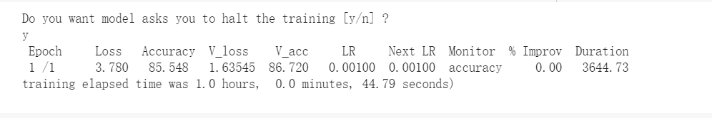
Create a pretrained model (using MobileNet)
Notes:
Use a more zoom-in scale to show the study area only:
Change the legend text
Add numbers for each parameter to describe the study area

Slide 6
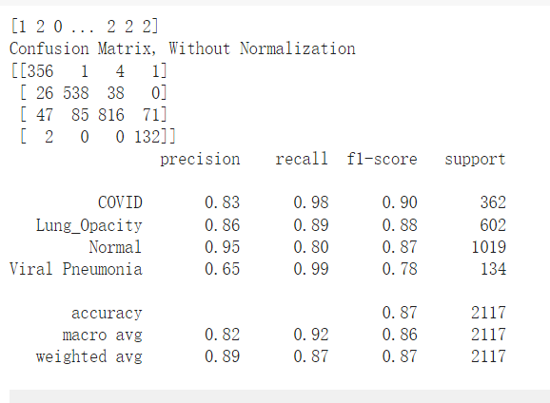
Results
MobileNet | Loss | Accuracy
Train | 1.6452089548110962 | 0.8706896305084229
Validation | 1.6188287734985352 | 0.8771551847457886
Test | 1.6244319677352905 | 0.8700991868972778
Notes:
Change the numbers in the table into square feet.
Change the header C and B into meaning terms.

Slide 7
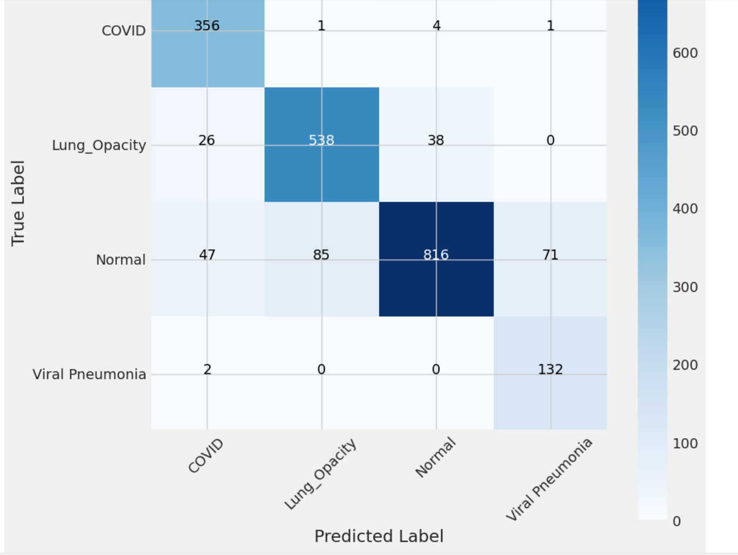
Notes:
Can we show the street names on the map?
The points is to be able to tell where this small section is located in the study area.

